Slide 1



DIAL-Malawi Use Case MNO, Disease, etc. data analysis

Slide 2
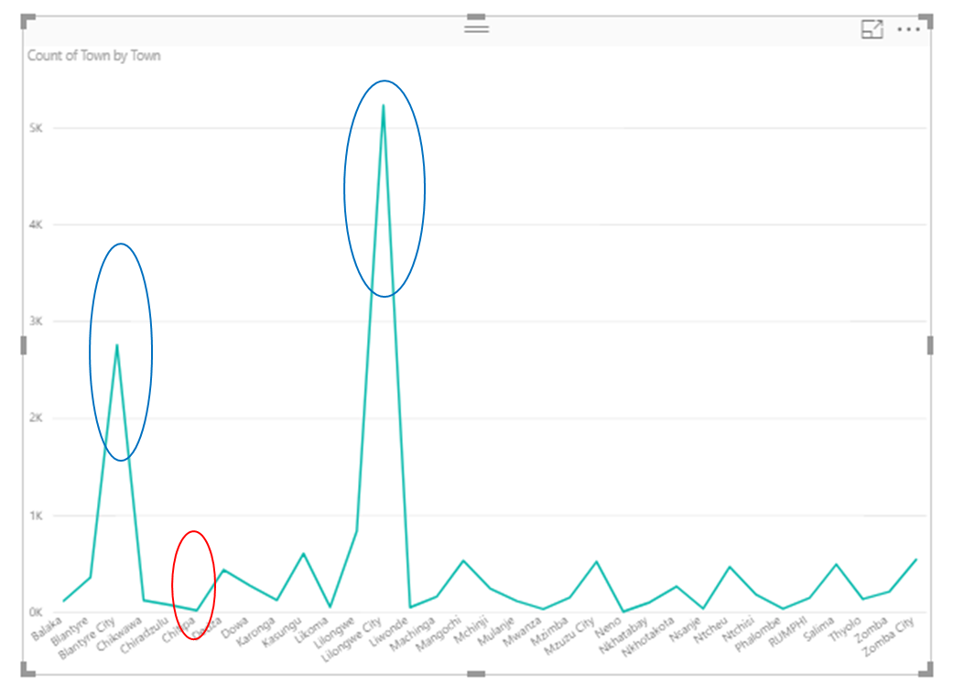
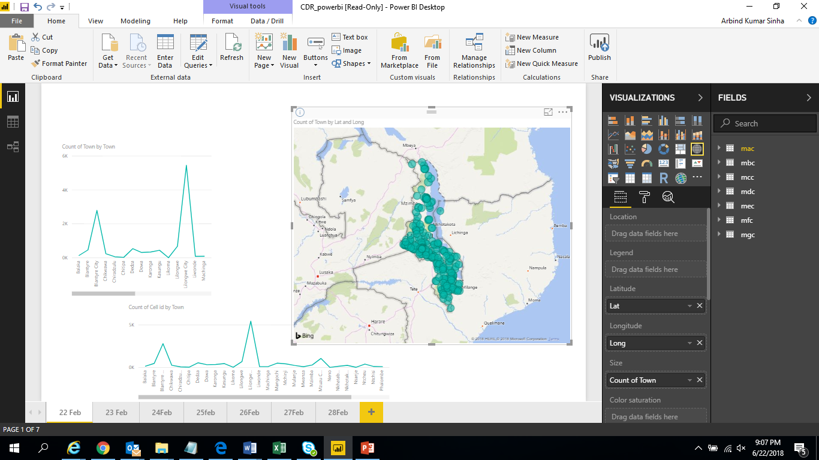
# of Calls made from Town/District – Summary of 22nd Feb - 28th Feb’18 Sample Data
For the given sample MNO data, it is found that -
Maximum # of calls are made from Lilongwe City town/district
2nd highest # of calls are made from Blantyre town/district
Lowest # of calls were made from Chitipa town/district
Notes:
Above graphs are created based upon MNO sample data

Slide 3
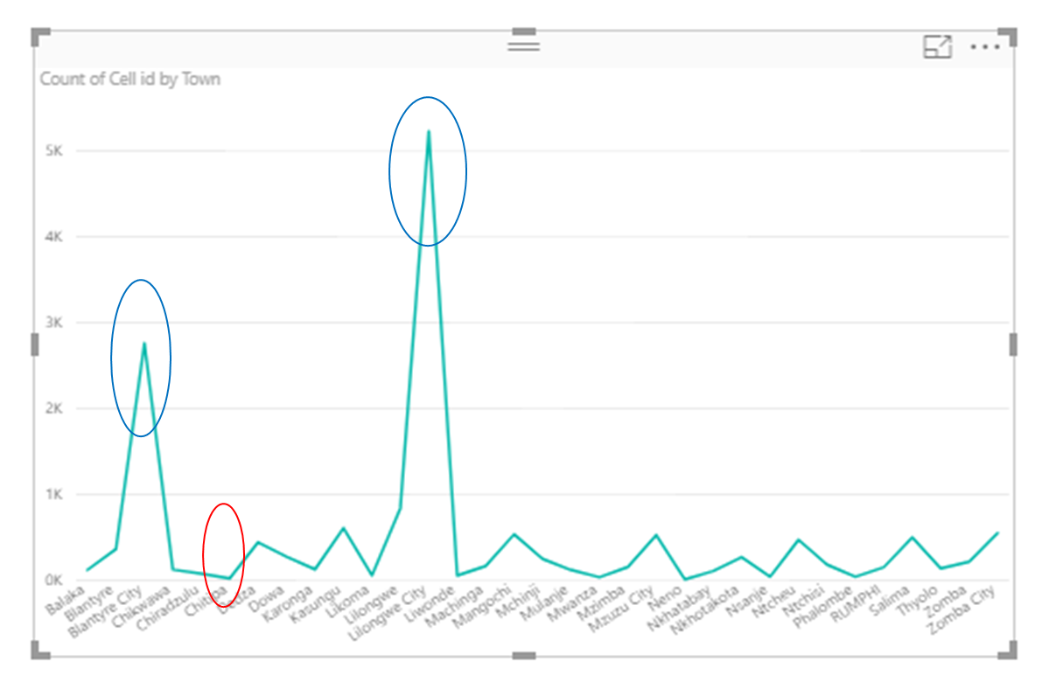
# of Cell/Tower id as per Town/District – Summary of 22nd Feb - 28th Feb’18 Sample Data
For the given sample MNO data, it is found that -
Maximum # of cell id are used In Lilongwe City
2nd highest # of cell id are used in Blantyre
Least # of cell id are used in Chitipa
Notes:
Above graphs are created based upon MNO sample data

Slide 4
Data Quality Report – Sample MNO Data for all seven days
Description | Data details
# of Cell Ids | 6755 (100%)
# of cell Ids for which Site Id missing | 2257 (33.4%)
# of cell Ids for which Town/district Id missing | 2257 (33.4%)
Day wise MNO sample data quality report is yet to be prepared
Notes:
There are many cell ids in sample CDR data for which Site id is not available (in Look up file).
There are many cell ids mentioned in Look up file which are not present in sample CDR data.

Slide 5
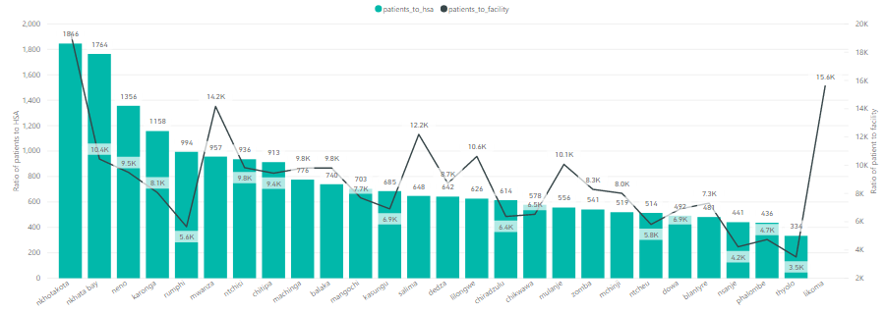
Proportion of Patients to HSA and Facility in each District
Likoma has no HSA’s which maybe the reason for a high facility burden in the district.
Nkhotakota has the highest burden on both HSA as well as facility.
Notes:
Datasets used Column Names
Disease Burden Data : opd patients and Facility Name
Master Health Facility List : Facility Name and Districts
UNICEF Population : Districts and Population
District Summary : HSA
Calculations done
--------------------
1. Merge Disease Burden and Master Health Facility List to get the facility and district mapping
2. Count the number of facilities(facility_count) in each district from the dataframe in step 1
3. Total opd patients(total_patients) in each district
4. Merge UNICEF Population, District Summary and dataframes 2&3 based on District (using only the specified columns)
5.C alculate proportions using the columns : patients_to_hsa= total_patients/HAS
patients_to_facility = total_patients/facility_count

Slide 6
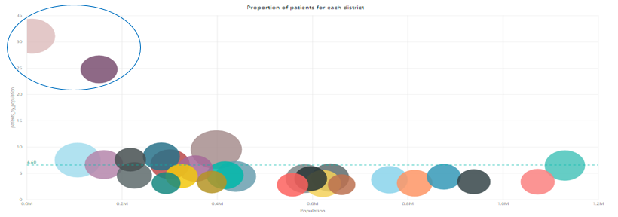
District-wise Patient Burden
Chart details:
x axis : Population
y axis : #patients/population
bubble size : facility burden
bubble color : district
Likoma and Zomba are two districts having 4-5 times more burden than average(6.6).
We proceed with our analysis for top 5 patient burdened districts since these are significantly different from other districts and requires special attention, especially during disease outbreak.
Notes:
Datasets used Column Names
Disease Burden Data : opd patients and Facility Name
Master Health Facility List : Facility Name and Districts
UNICEF Population : Districts and Population
Calculations done
--------------------
1. Merge Disease Burden and Master Health Facility List to get the facility and district mapping
2. Count the number of facilities(facility_count) in each district from the dataframe in step 1
3. Total opd patients(total_patients) in each district
4. Merge UNICEF Population and dataframes 2&3 based on District (using only the specified columns)
5. Calculate proportions using the columns : patients_by_population= total_patients/population
patients_to_facility = total_patients/facility_count

Slide 7
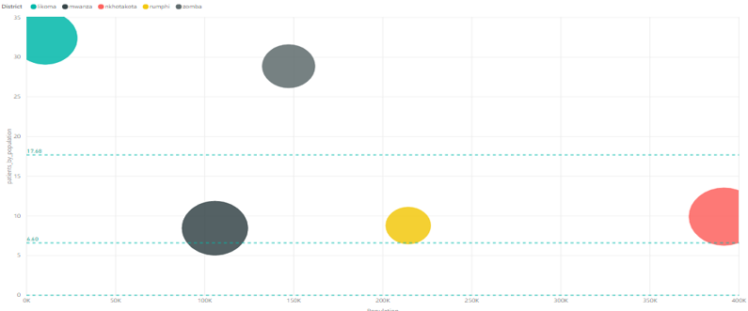
Patient Burden-Top 5 Districts
Burden on top 5 districts average burden is 2.67 times more burdened than country’s(all districts) burden.
Notes:
Datasets used Column Names
Disease Burden Data : opd patients and Facility Name
Master Health Facility List : Facility Name and Districts
UNICEF Population : Districts and Population
Calculations done
--------------------
1. Merge Disease Burden and Master Health Facility List to get the facility and district mapping
2. Count the number of facilities(facility_count) in each district from the dataframe in step 1
3. Total opd patients(total_patients) in each district
4. Merge UNICEF Population and dataframes 2&3 based on District (using only the specified columns)
5. Calculate proportions using the columns : patients_by_population= total_patients/population
patients_to_facility = total_patients/facility_count
filtering top 5 in power bi

Slide 8
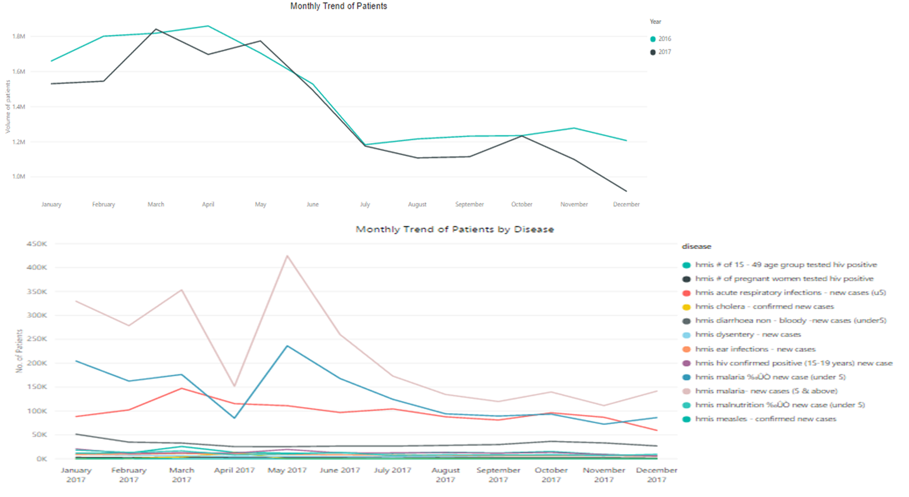
Disease Burden Data - Few Interesting Facts
The graphs show the trend of patients and diseases.
Malaria, respiratory infections and HIV account for the major diseases prevalent in Malawi.
Notes:
Datasets used Column Names
Disease Burden Data : Month, Year, opd patients and diseases
Calculations done
--------------------
1. Process the disease burden data to extract the month, year and disease information

Slide 9
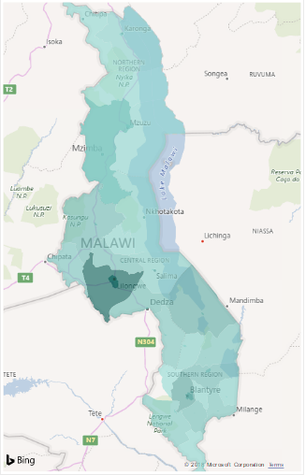
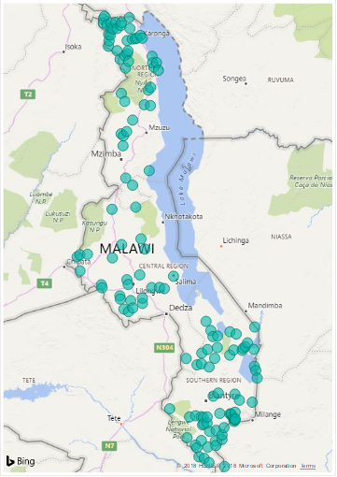
Population Density and Distribution of Health Posts
Population density
Distribution of health posts
Northern region of Malawi has low population density but there are comparatively more health posts than the Central region which has high population density
Notes:
Datasets used Column Names
Disease Burden Data : Month, Year, opd patients and disease
Master Health Facility List : Districts, Eastings and Northings
District Summary : Districts and Populations

Slide 10

Thank You

